Slide 1
Issue Tracker
An issue tracker is the all-in-one solution for streamlining the customer service experience.
It is a method for keeping a record of open problems that, depending on the particular content.
Tracker can be used at any point, during the project life cycle, to monitor points in question, problems that need resolution.

Slide 2
Procedures
Note the issue as it occurs.
Status and close when completed.
Capture new issues.
Update the tracker on daily basis.

Slide 3
Updating issues in excel-sheet
Update the following in the sheet:
RITM
Incident
Change Request

Slide 4
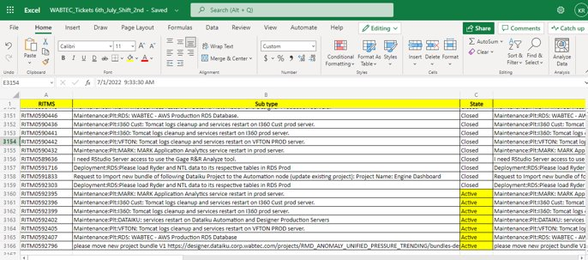
RITM Sheet Update all the tickets which receive by the users. Here we can track the state of the ticket. Such as: Active or close, description, create date, assigned person name and group.

Slide 5
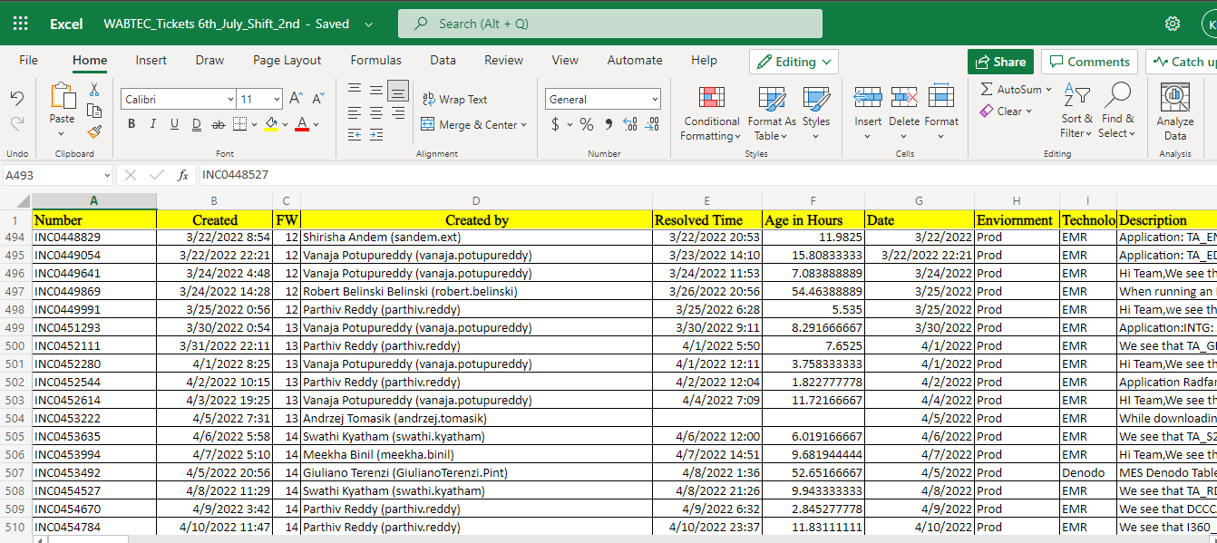
Incident Sheet Here we can track the state of the incident. Such as: Incident number, Description, create date, Fiscal Week, Created by, Age in hours, date, Environment, Technology, Assigned person & group, configuration item, issue related.

Slide 6
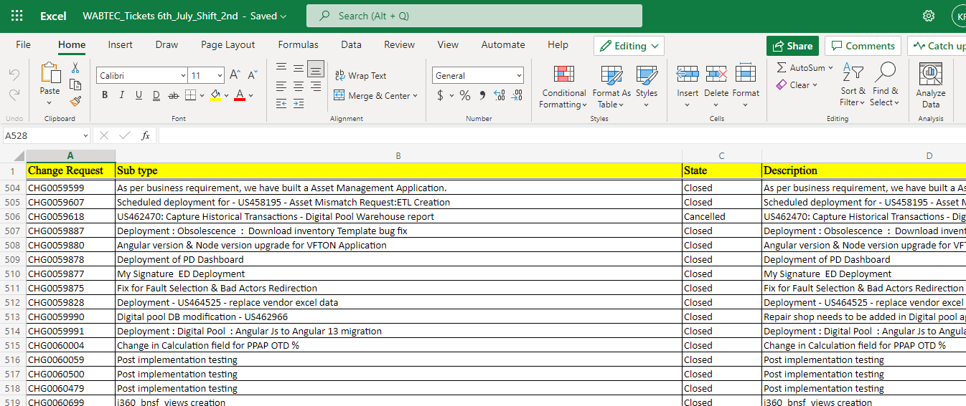
Change Request Sheet Update all the CR which are approved by the CAB team. Here we can track the CR's. Such as: Change Request, Sub type, State, Description, Change Request Type, Created Date, Opened By, Assignment Group, Assigned To, Scrum Master, Developer, Scheduled /Un-Scheduled, Approver, Issue related, Roll back.

